Slide 1

Western Countries Financial Data – Capstone Project
Presented by – Punith Naik

Slide 2
Contents :
Introduction
Data Exploration Business Insights
Problem Statement
Profitability Analysis
Discount & Margin Evaluation
Geographical Insights
Key Issues Identified
Strategic Recommendations
Conclusion & Next Steps

Slide 3
1, Exploring the Data using Excel. Understanding the data and preparing a short summary about the dataset.
📊 Dataset Summary
700 financial records from multiple Western countries
Covers 2014–2017, with monthly sales transactions
🧾 Key Attributes
Segments: Government, Midmarket, Channel Partners
Products: Carretera, Montana, Paseo, Velo, VTT
Metrics: Units Sold, Sales, Profit, COGS, Discounts
🌍 Geographic Scope
Countries: Germany, Canada, Mexico, France, etc.
📈 Insights Enabled
Profitability by segment & region
Product sales performance
Seasonal & trend analysis
Forecasting via Sheet2 (with confidence bounds)

Slide 4
Problem Statement
"Although the company maintains strong overall sales and a well-distributed market presence across countries, profit margins vary significantly across segments and products. The Enterprise segment consistently operates at a loss, and the current high-discount approach may be undermining profitability. The objective is to uncover actionable insights to refine product mix, pricing strategies, and customer segmentation to enhance overall profit without compromising sales performance."

Slide 5
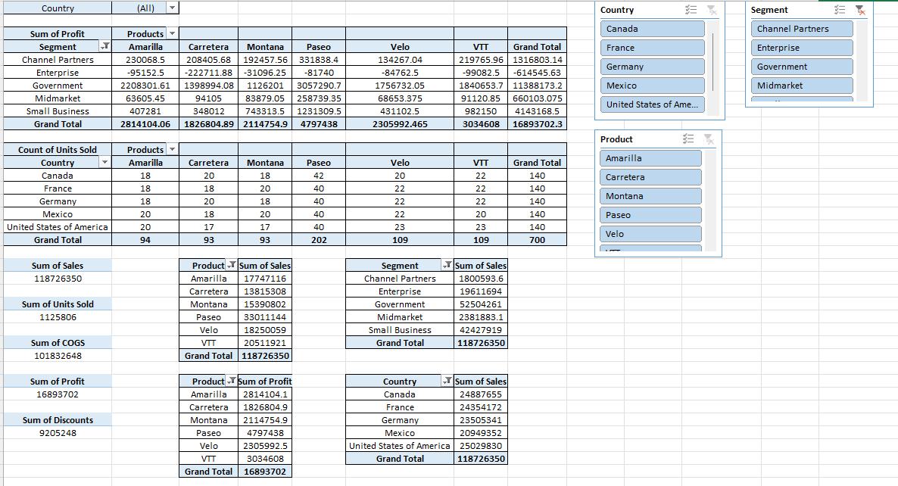
2, Performing Data cleaning if required and then doing Statistical Analysis on data using statistical tools.

Slide 6
📌 Business Insights from Financial Data
💰 Most Profitable Segment
Government is the most profitable segment, with a total profit of $11,388,173.
Small Business ranks second with $4,143,169 in total profit.
Enterprise is loss-making with a total profit of $–614,546, indicating potential pricing or cost issues in that segment.
🌍 Top Performing Countries by Sales
United States of America leads with the highest sales: $25,029,830
Canada: $24,887,655
France: $24,354,172
👉 All Three listed countries have strong revenue performance, suggesting a balanced distribution of market presence.

Slide 7
🚴‍♂️ Product-wise Performance
🔝 Top 3 Products by Units Sold:
Paseo – 202 units.
Velo & VTT - 109 units each.
Amarilla – 94 units.
Paseo generates the highest total profit: $4,794,738, making it a strong performer both in units and margin.
📉 Segment-Product Observations
Government segment + VTT combo alone delivers ₹1.84 million in profit a major contributor.
Enterprise segment shows losses across all product types, especially Carretera and Velo, which need pricing or cost review.
🎯 Strategic Recommendations:
Focus on expanding Government and Small Business segments.
Re-evaluate the Enterprise segment, especially product pricing or discount strategies.
Maintain inventory for Velo, Amarilla, and Montana, given their high sales volume.
Strengthen presence in the U.S., Canada, and France, as they are your most lucrative markets.

Slide 8
3,Graphical Analysis & Insights Derivation using Excel:
Western Countries Financial Data
Total Sales $118.73M
Total Discount $ 95.05M
Total Profit $ 168.93M
Total COGS $ 101.83M
Total Units Sold $ 112.58M

Slide 9
.
📊 Graphical Analysis Insight
📈 1. Paseo is the Top Performing Product
Highest profit: ~$4.8M
Highest units sold among all products 👉 Indicates strong market demand and pricing advantage.
🌎 2. Sales Are Equally Spread Across Countries
Canada (21%), France (21%), Germany (20%), USA (20%), Mexico (18%) 👉 The business has a balanced geographical footprint, reducing dependency on a single market.
👥 3. Government Segment Dominates Sales
It also shows maximum sales counts across multiple products.
44% of total sales comes from the Government segment. 👉 Suggests government contracts are a major revenue stream.

Slide 10
💰4. Product Profitability Table
Although Paseo and Velo are top in units, Amarilla and VTT generate higher profits per unit.
👉 Focus on high-profit, medium-selling products like Amarilla for better margins.
💵 5. High Discounts with High Sales
Despite $95M+ in total discounts, the company achieved $118.73M sales 👉 Discount strategy is possibly driving volume, but needs margin analysis.
🎯 6. Business Recommendations
Double down on Government and Small Business segments.
Investigate low performance in Enterprise and Midmarket (may be pricing or product fit).
Invest in boosting sales of high-profit products like Amarilla.
👉 Streamline or reposition low-performing products like Carretera.

Slide 11

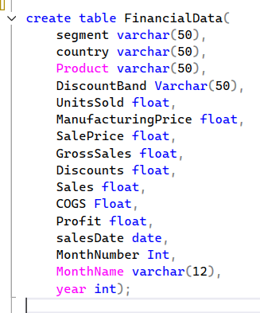
4, Insert the given data into the SQL server by making a Database defining the required parameters for the construction of Database and Database tables.
11

Slide 12



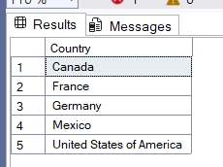
5, Verify if the data is properly imported into the SQL database(Try running few Queries)
✅ Easy Level (Basic Verification)
How many total records (rows) are there in the imported table?
Input :
Output :
2. List all the distinct countries present in the dataset.
Input :
Output :

Slide 13


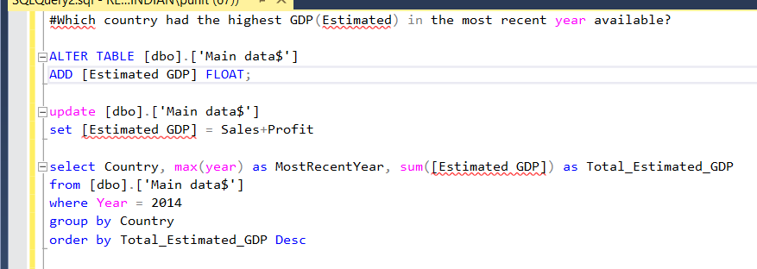
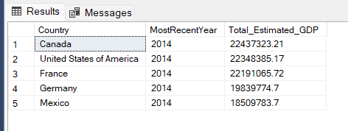
✅ Easy Level (Basic Verification)
3. What is the range (min and max) of years available in the data?
Input :
Output :
🔄 Intermediate Level (Value Checks & Aggregates)
1, Which country had the highest GDP(Estimated) in the most recent year available?
Input :
Output :

Slide 14
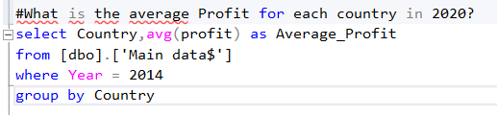
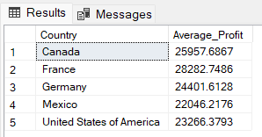
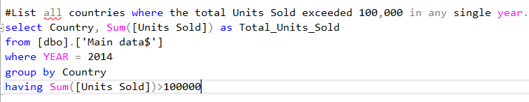
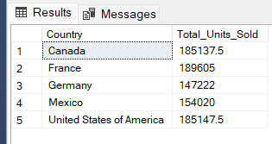
🔄 Intermediate Level (Value Checks & Aggregates)
2, What is the average Profit for each country in 2020?
Input :
Output :
3,List all countries where the total Units Sold exceeded 100,000 in any single year.
Input :
Output :

Slide 15
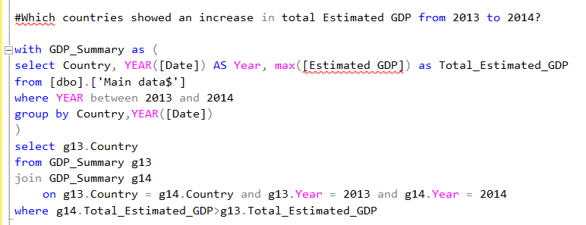
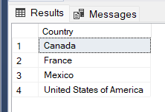
🧠 Moderate Difficulty Questions
1, Which countries showed an increase in total Estimated GDP from 2013 to 2014?
Input :
Output :

Slide 16
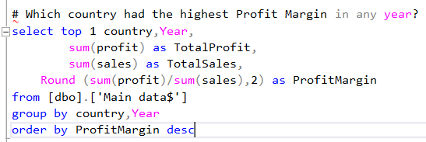
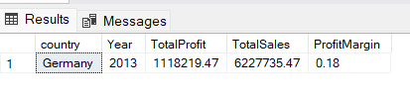
🧠 Moderate Difficulty Questions
2, Which country had the highest Profit Margin in any year?
Input :
Output :

Slide 17
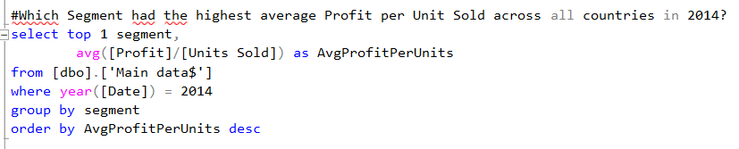

🧠 Moderate Difficulty Questions
3, Which Segment had the highest average Profit per Unit Sold across all countries in 2014?
Input :
Output :

Slide 18
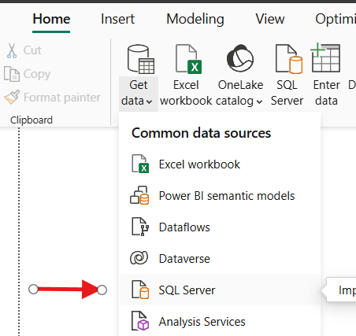
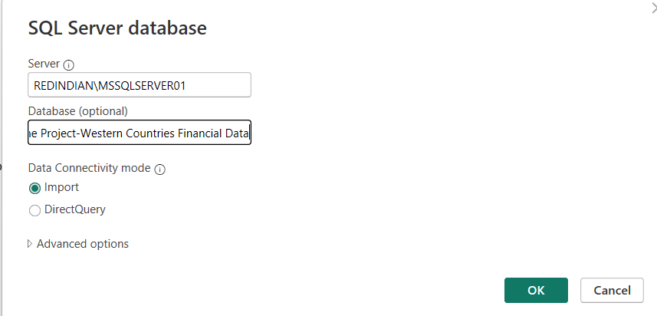
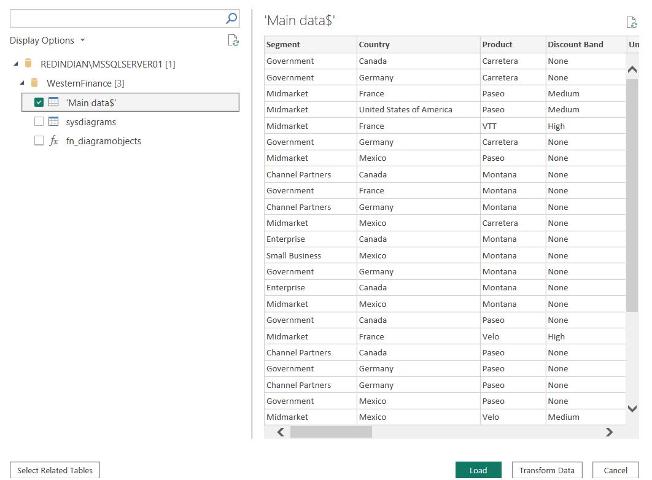
6, Import the Data from the SQL Database into Power-BI , verify if the data is properly imported or not.
→
→
1.Open Power BI desktop
2. Click Get Data →SQL Server → enter server name → Ok
3. Select the required worksheet ,then click Load.

Slide 19
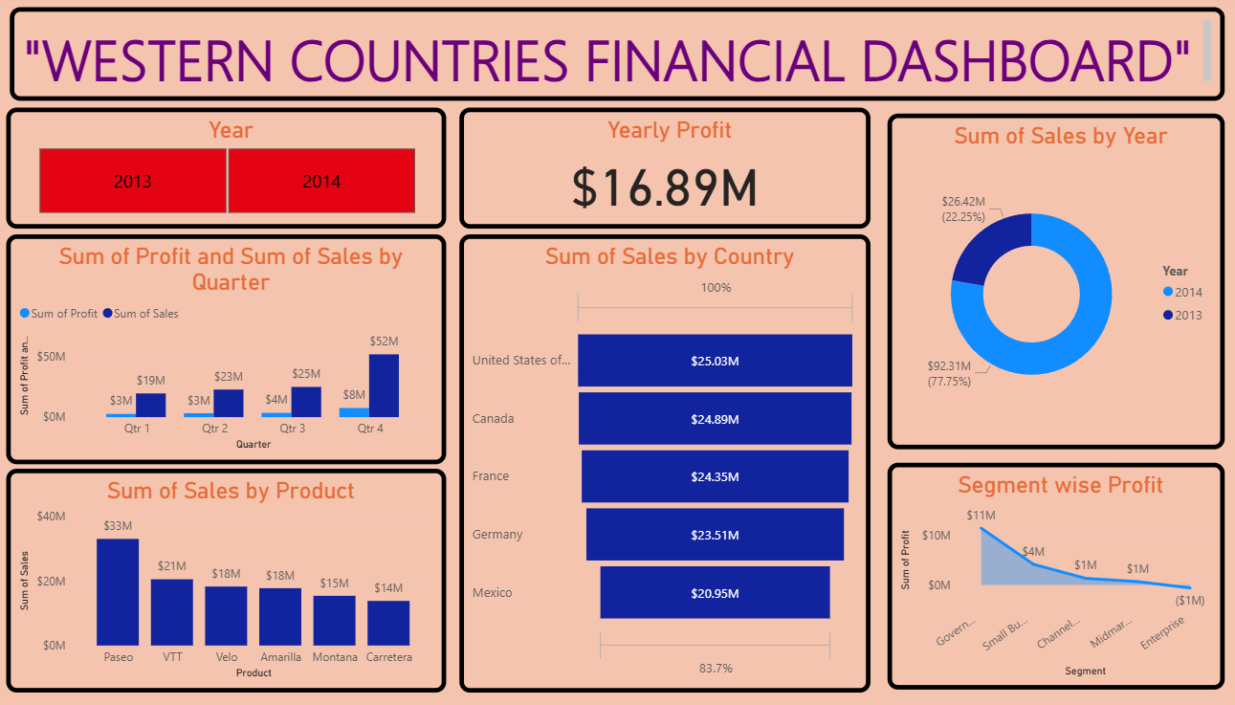

Slide 20
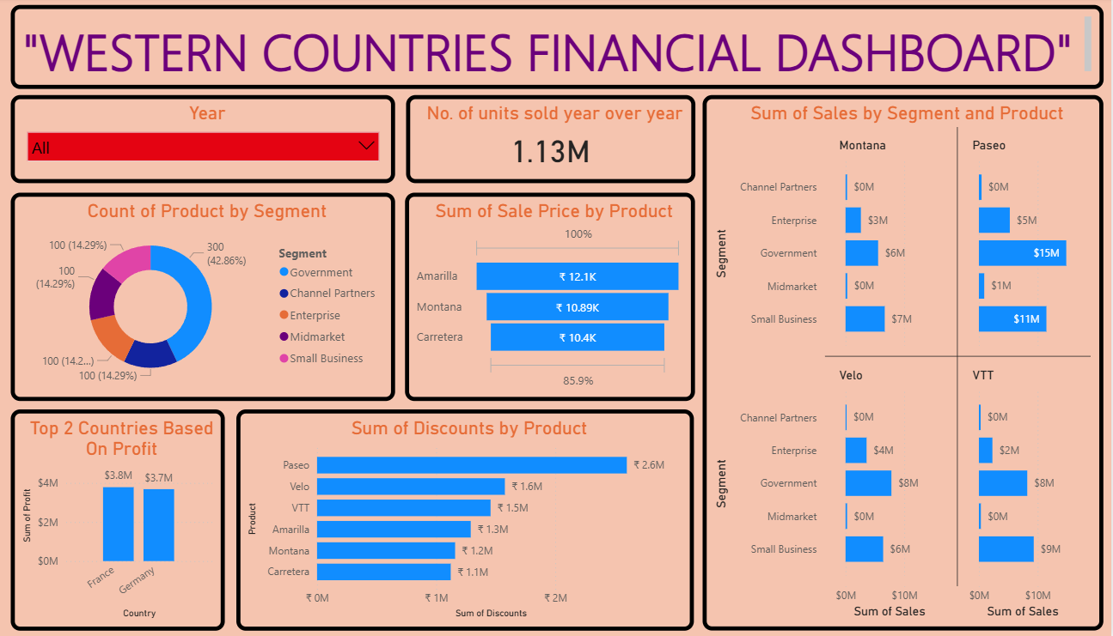

Slide 21
Western Countries Financial Summary – Key Insights
Top Product 🏆 | Paseo – Highest in Sales ($33M) & Profit (~$4.8M)
Best Segment 🏢 | Government – Most Profitable ($11M)
Top Country by Profit 🌍 | France & Germany – ~ $4M each
YoY Growth 📈 | 2014 Sales (77%) > 2013 (22%) – Strong Growth
High Discount 💸 | Paseo – Got highest discount ($2.6M), still top

Slide 22
Thank you

